Slide 1
Advanced Programming
Module Project
Module: Web Development Using Platforms
Start Date : 14/11/2022
End Date : 14/11/2022
Submission Date : 12/12/2022
Learner Name :Chathushi Jayarathna
Enrollment ID :
Presentation Date :

Slide 2
Contents
Contents
S. No. | Description
01 | List of software used
02 | OO Paradigm
03 | Class Relationships
04 | Class Diagram
05 | Developing Triple A portlet
06 | Customer Management Portlet
07 | Design Patterns
08 | Creational Design Patterns
09 | Structural Design Patterns
10 | Behavioural Design Patterns
11 | . Milestone Feedback & Action taken
12 | Proposed Improvements

Slide 3
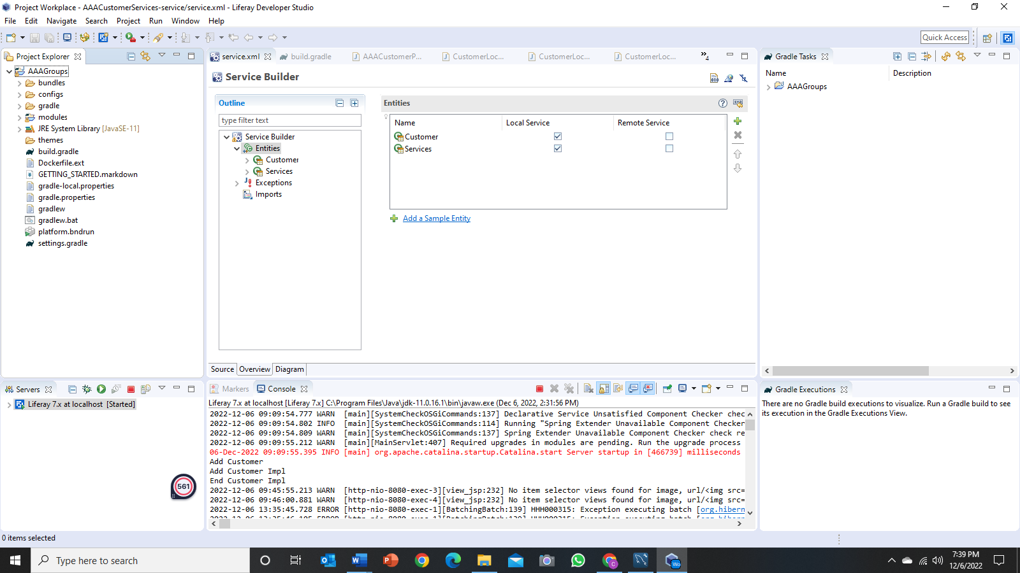

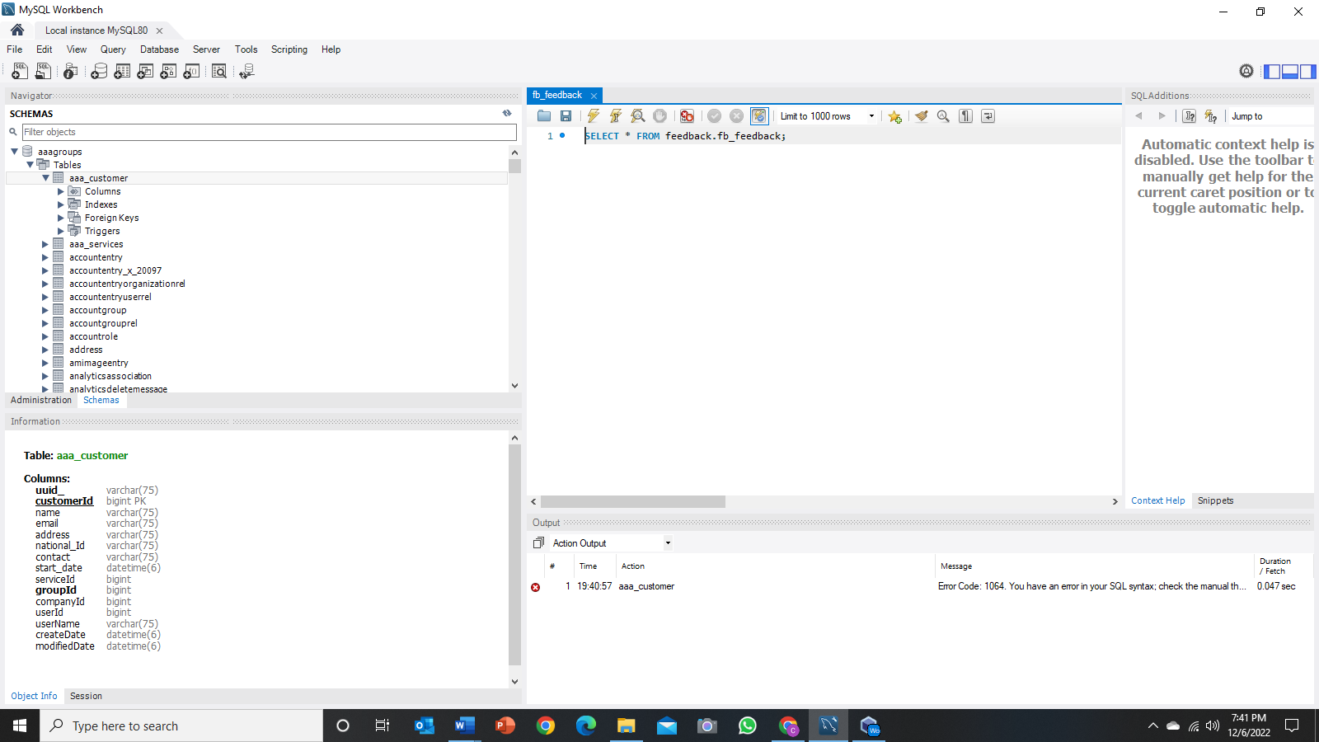
1. List of software used
Developer Studio - Eclipse IDE
MySQL Workbench

Slide 4

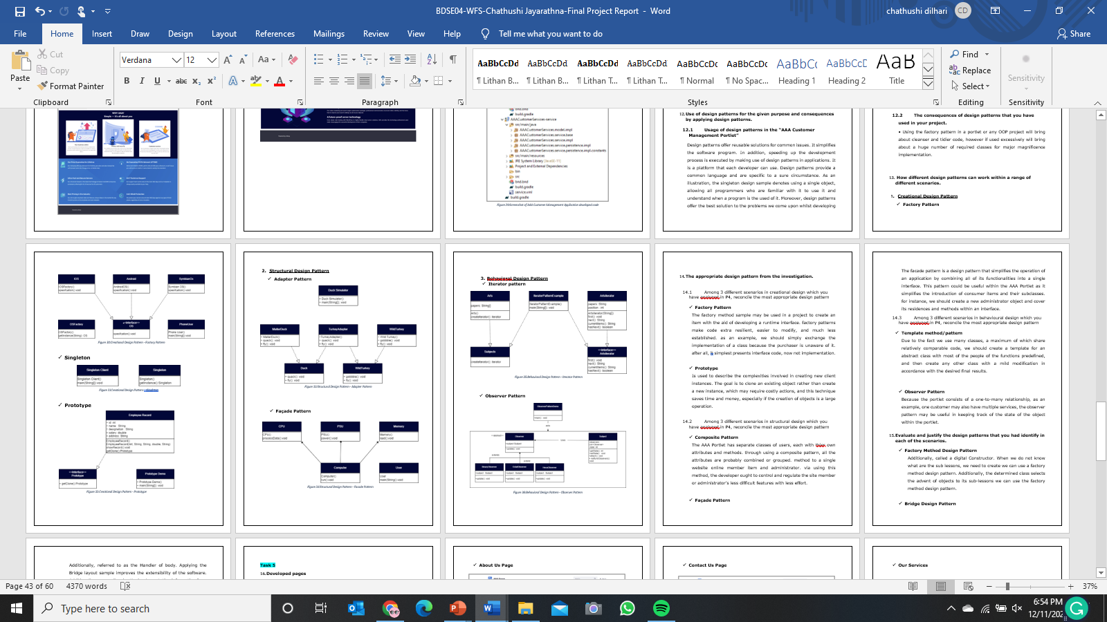

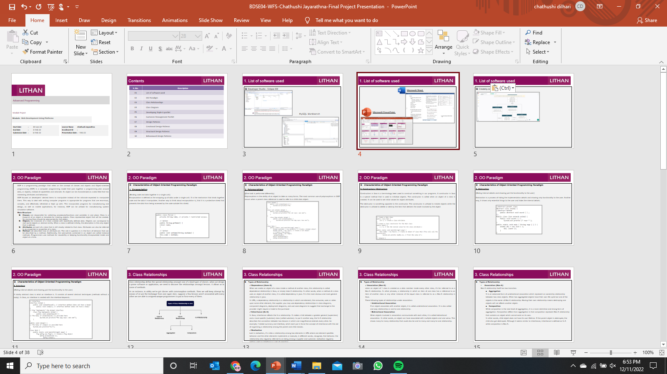
1. List of software used
Microsoft Word
Microsoft PowerPoint

Slide 5

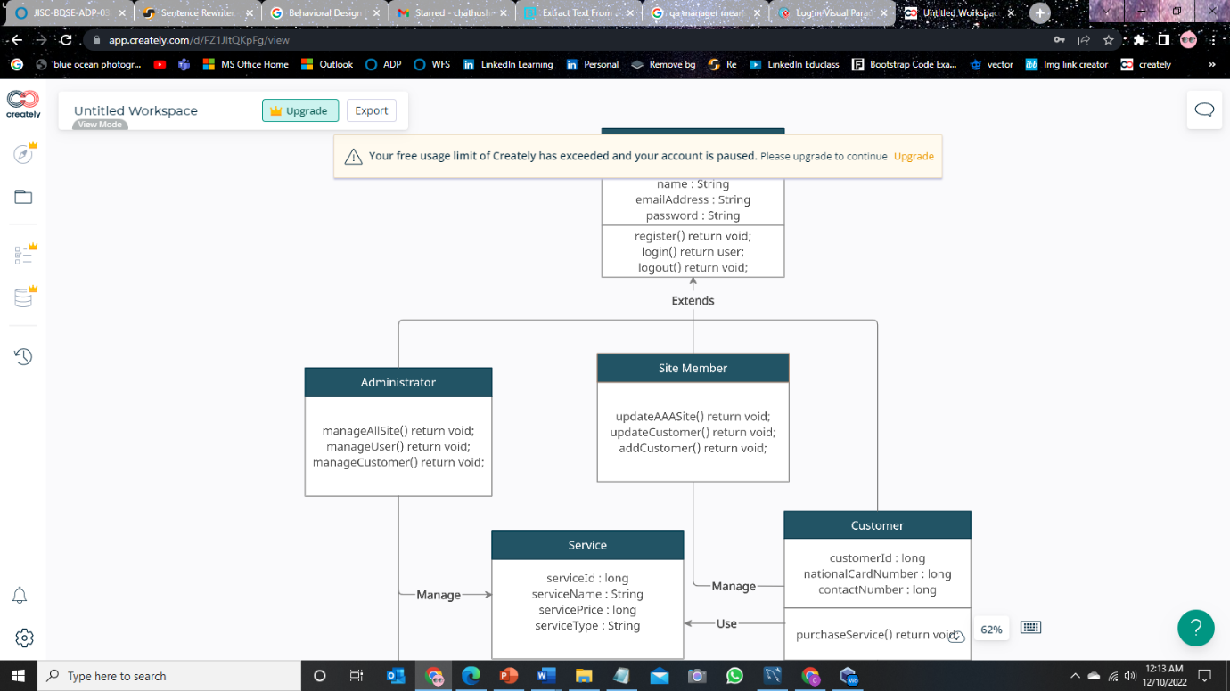
1. List of software used
Creately.com

Slide 6
2. OO Paradigm
OOP is a programming paradigm that relies on the concept of classes and objects and Object-oriented programming (OOP) is a computer programming model that puts together a programming plan around data, or objects, instead of capabilities and rationale. An object can be characterized as a data field that has interesting attributes and behaviour.
OOP focuses on developers' desired items to manipulate instead of the rationale expected to manipulate them. This way to deal with writing computer programs is appropriate for programs that are enormous, complex, and effectively refreshed or kept up with. This incorporates programs for manufacturing and design, as well as mobile applications; for instance, OOP can be utilized for manufacturing system simulation software.
Main Structure
Classes are responsible for collecting procedures/functions and variables in one place. Class is a blueprint of an object or template for creating objects. Class represented object that will be created. So naming Class should be appropriate for the object.
Objects are instances of a class created with specifically defined data. Objects can correspond to real-world objects or abstract entity. When a class is defined initially, the description is the only object that is defined.
Attributes are part of a class that is still closely related to that class. Attributes can also be referred to as properties or properties of a class.
Method role describes how an attribute act. The role in question is in the form of behavior that can be described by a method. Additionally, the subroutines contained in an object are called instance methods. Programmers use methods for reusability or keeping functionality encapsulated inside one object at a time.

Slide 7
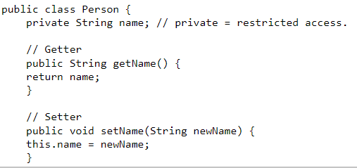
2. OO Paradigm
Characteristics of Object Oriented Programming Paradigm
1. Encapsulation
(Binding code and data together in a single unit)
Encapsulation is defined as the wrapping up of data under a single unit. It is the mechanism that binds together code and the data it manipulates. Another way to think about encapsulation is, that it is a protective shield that prevents the data from being accessed by the code outside this shield.

Slide 8
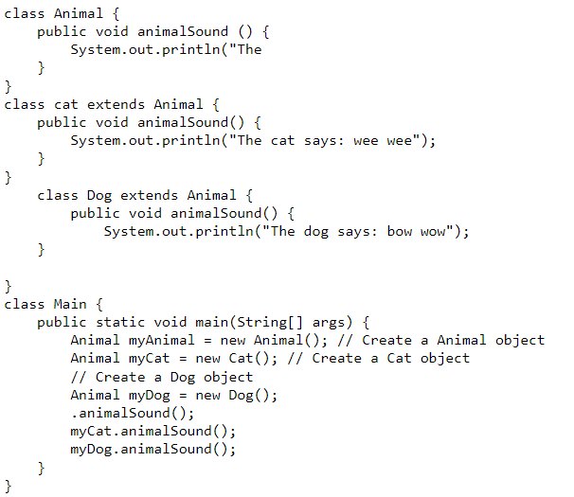
2. OO Paradigm
Characteristics of Object Oriented Programming Paradigm
2. Polymorphism
(One task is performed differently)
Polymorphism is the ability of an object to take on many forms. The most common use of polymorphism in OOP occurs when a parent class reference is used to refer to a child class object.

Slide 9
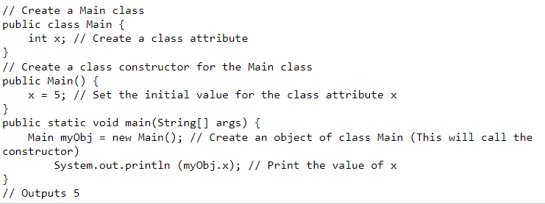
2. OO Paradigm
Characteristics of Object Oriented Programming Paradigm
3. Constructors/ Destructors
Constructors in Java is a terminology been used to construct something in our programs. A constructor in Java is a special method that is used to initialize objects. The constructor is called when an object of a class is created. It can be used to set initial values for object attributes.
The destructor is something opposite to the constructor. The constructor is utilized to instate objects while the destructor is utilized to delete or destroy the item that delivers the asset involved by the object

Slide 10
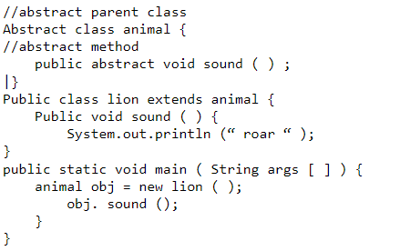
2. OO Paradigm
Characteristics of Object Oriented Programming Paradigm
4. Abstraction
(Hiding internal details and showing just the functionality to the user)
Abstraction is a process of hiding the implementation details and showing only functionality to the user. Another way, it shows only essential things to the user and hides the internal details.

Slide 11
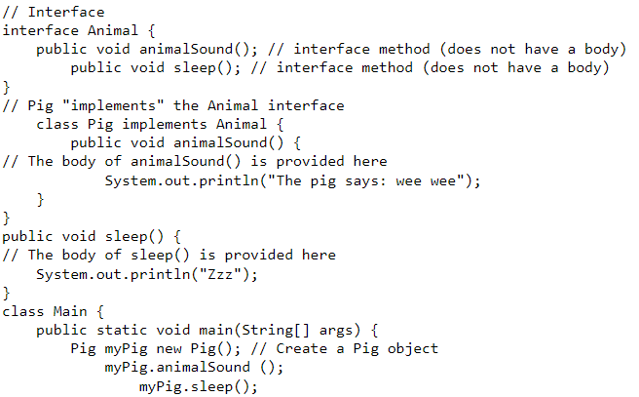
2. OO Paradigm
Characteristics of Object Oriented Programming Paradigm
5. Interface
(Hiding internal details and showing just the functionality to the user)
A totally abstract class is what an interface is. It consists of several abstract techniques (methods without a body). In Java, an interface is created with the interface keyword..

Slide 12
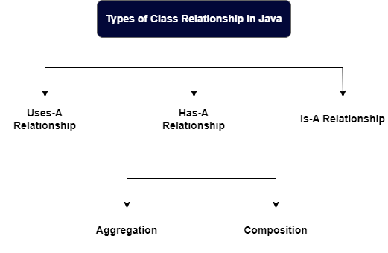
3. Class Relationships
Class relationship define the special relationship amongst one of a kind types of classes. when we design a prime software or application, we need to discover the relationships amongst lessons. It allows us in some of methods.
As an instance, in utility we've got classes with commonplace methods. Then we will keep attempt by means of re-use the technique from one super class. suppose a few lessons aren't associated with every other we are able to assigned unique programmers to put in force every of them.

Slide 13
3. Class Relationships
Types of Relationship
Dependence (Uses-A)
When we create an object of a class inside a method of another class, this relationship is called dependence relationship in Java, or simply Uses-A relationship. In other words, when a method of a class uses an object of another class, it is called dependency in java. It is the most obvious and most general relationship in java.
In UML, a dependency relationship is a relationship in which one element, the consumer, uses or relies upon some other element, the supplier. you may use dependency relationships in class diagrams, component diagrams, deployment diagrams, and use-case diagrams to suggest that exchange to the provider might require a trade to the purchaser
Inheritance (Is-A)
In Java, inheritance reflects the Is-a relationship. It makes a link between a greater general (superclass) and a more specific (subclass) class (called subclass). to put it another way, the Is-A relationship describes the connection between two lessons in which one magnificence extends every other. for example, I stated summary and interface, which each put in force the concept of inheritance with the aid of organising a relationship among the parent and child classes.
Realization
Last is realization, it's miles a relationship among two elements in UML where one element specifies behavior and the other elements implements or execute, in different words, recognize, that behavior. the relationship also regularly referred to as being among a supplier and customer. realization regularly getting used on interface or a set of operation.

Slide 14
3. Class Relationships
Types of Relationship
Association (Has-A)
when an object of 1 class is created as a data member inside every other class, it's far referred to as a Has-A relationship. In other phrases, a relationship in which an item of one class has a reference to an item of another class or any other instance of the equal class is referred to as a Has-A relationship in Java.
There following types of relationships under association:
- Unidirectional Association
If an object associates with another object, it is called unidirectional association. It is also called one-way relationship or one-to-one relationship.
- Bidirectional Association
When objects involved in association communicate with each other, it is called bidirectional association. In other words, an object can have associated with multiple objects and vice versa. This shows many-to-many relationship that could also be one-to-many and many-to-one relationship.

Slide 15
3. Class Relationships
Types of Relationship
Association (Has-A)
Has-A relationship itself has two branches:
Aggregation
It is an advanced form of unidirectional association which represent an ownership relationship between two class objects. When two aggregated objects have their own life cycle but one of the objects is the owner of Has-A relationship. Having their own relationship means destroying one objects will not affects another object.
Composition
While composition is the next level of aggregation, it is a more restrictive and strong form of aggregation. Composition differs from aggregation is that composition represent Has-A relationship that contains an object which cannot exist on its own.
In other words, child object does not have its own lifetime. If the parent object is destroyed, the child also got destroyed. Although it seems similar to inheritance, inheritance is defined as Is-A while composition is Has-A.

Slide 16
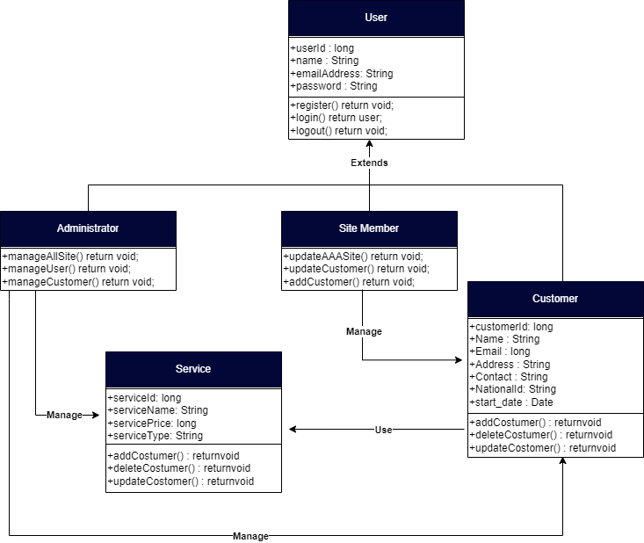
4. Class Diagram
Class Diagram based on project scenario using UML

Slide 17
4. Class Diagram
Class Diagram based on project scenario using UML
Users are divided into 2 as admin and site members. Admin can manage the customer and manage the offerings and a member of the website can manipulate the consumer. The relationship between services and clients is composition, i.e. Composition of clients. Customers exist or are created if someone wishes services. Inheritance is used for admin, website member and user classes as inheritance lets in us to put in writing applications that require fewer base and super classes. Inheritance creates a subclass which can use the methods of its superclass without rewriting the code for the
ones methods. For customer and services, composition, service, and client are associated with every other. Whenever there may be a customer which means there must be a service. Admin makes use of customer and service association; admin can manage consumer and service.
Class | Attributes | Methods | Explanation
Admin |  | manageSite() manageAllUser() manageService() | A class named Admin inherits the residences of the user class and the admin can manage the web site in various project record NICF Capstone assignment the usage of Java page | 48ways. It has information control skills and internet site access.
Customer | Name Email Address Contact Start_date Service_Name | provideInformation() | A class that gets the attribute from the user. On the grounds that a record of a customer who purchased a service requires more particular records, numerous attributes have been introduced
Site Member |  | editCustomer() removeCustomer() addCustomer() addContent() editContent() removeContent() | The web page Member class inherits properties from the user class, a designation that influences both content and information approximately the customer.

Slide 18

5. Developing Triple A portal
Home Page

Slide 19
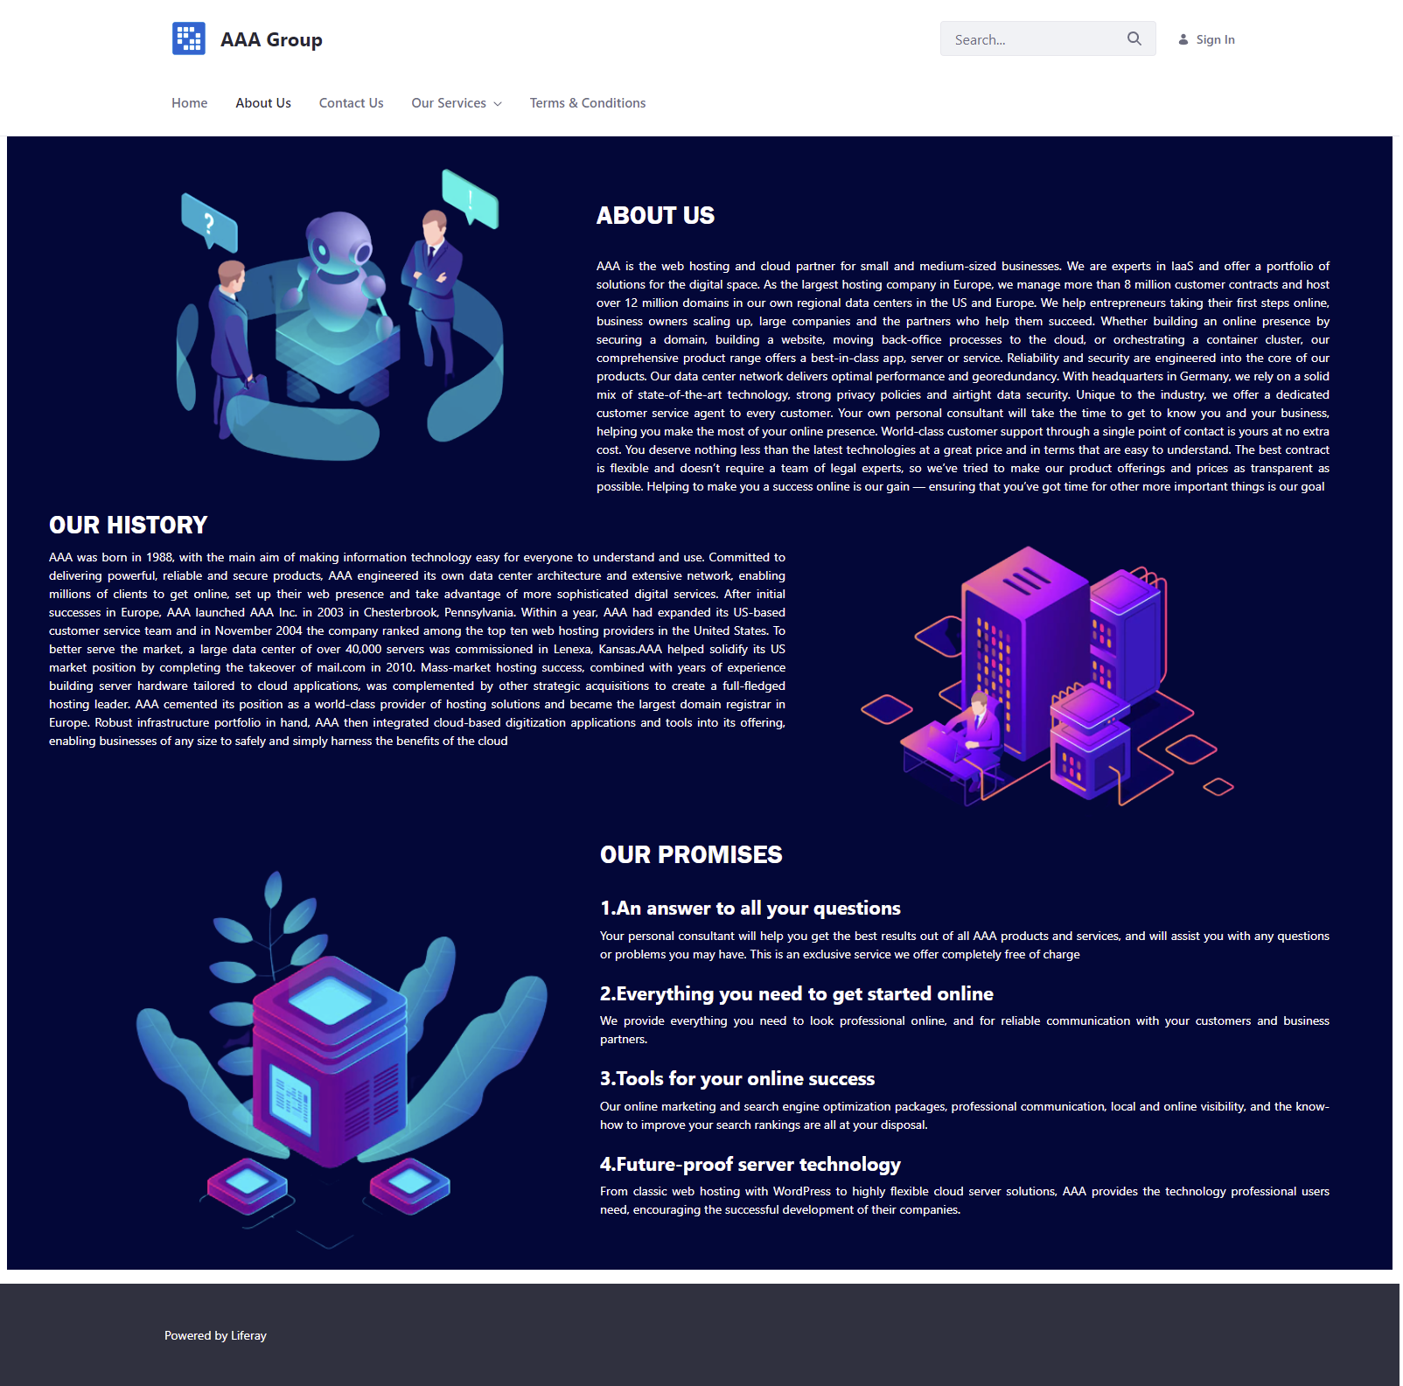
5. Developing Triple A portal
About Us

Slide 20
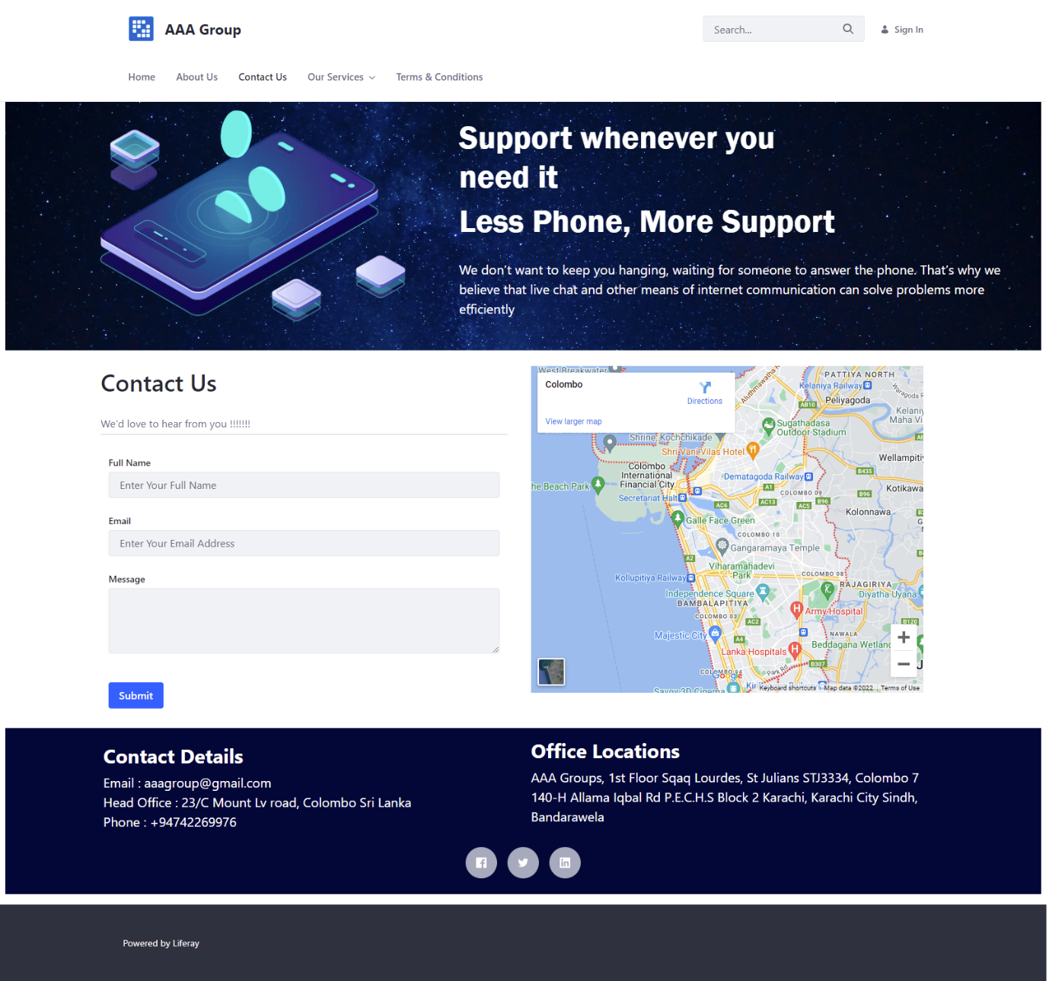
5. Developing Triple A portal
Contact Us

Slide 21
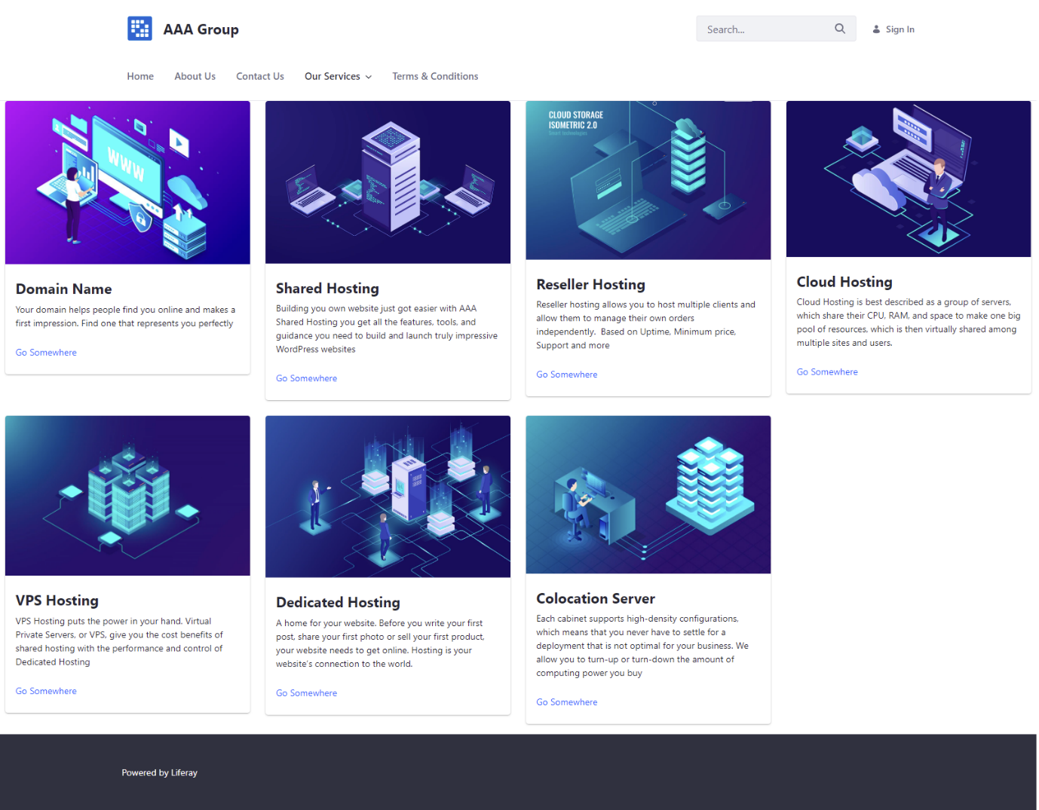
5. Developing Triple A portal
Our Services

Slide 22
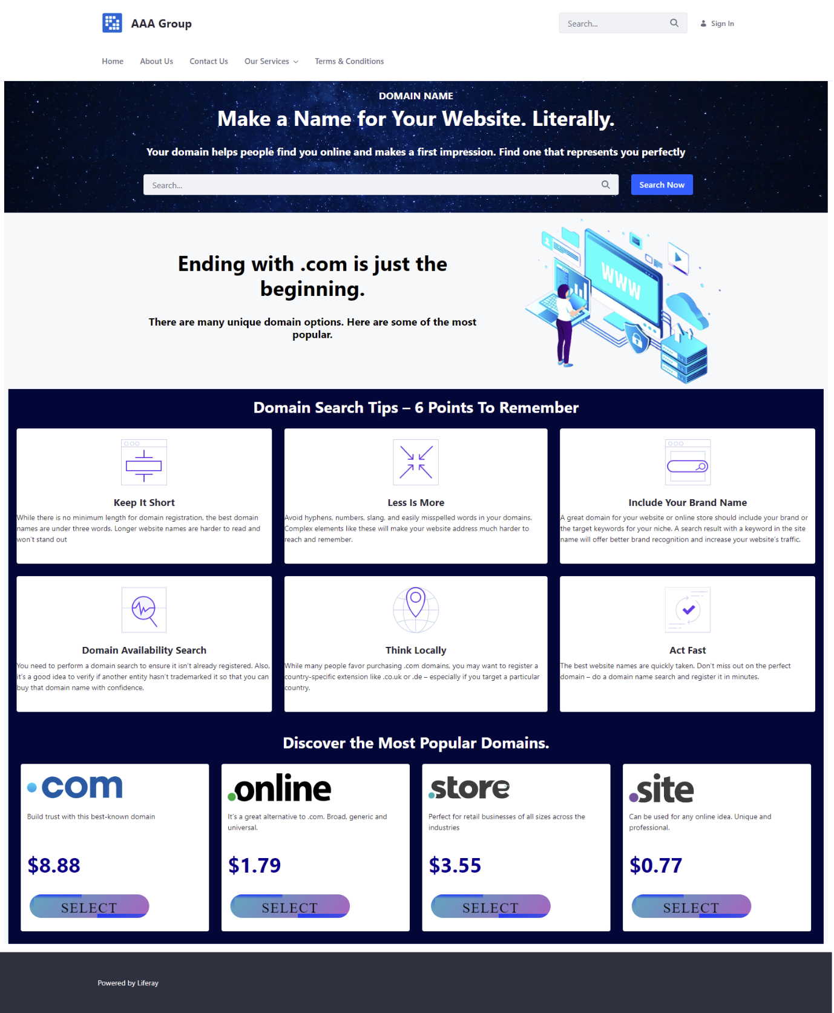
5. Developing Triple A portal
Domain Name

Slide 23
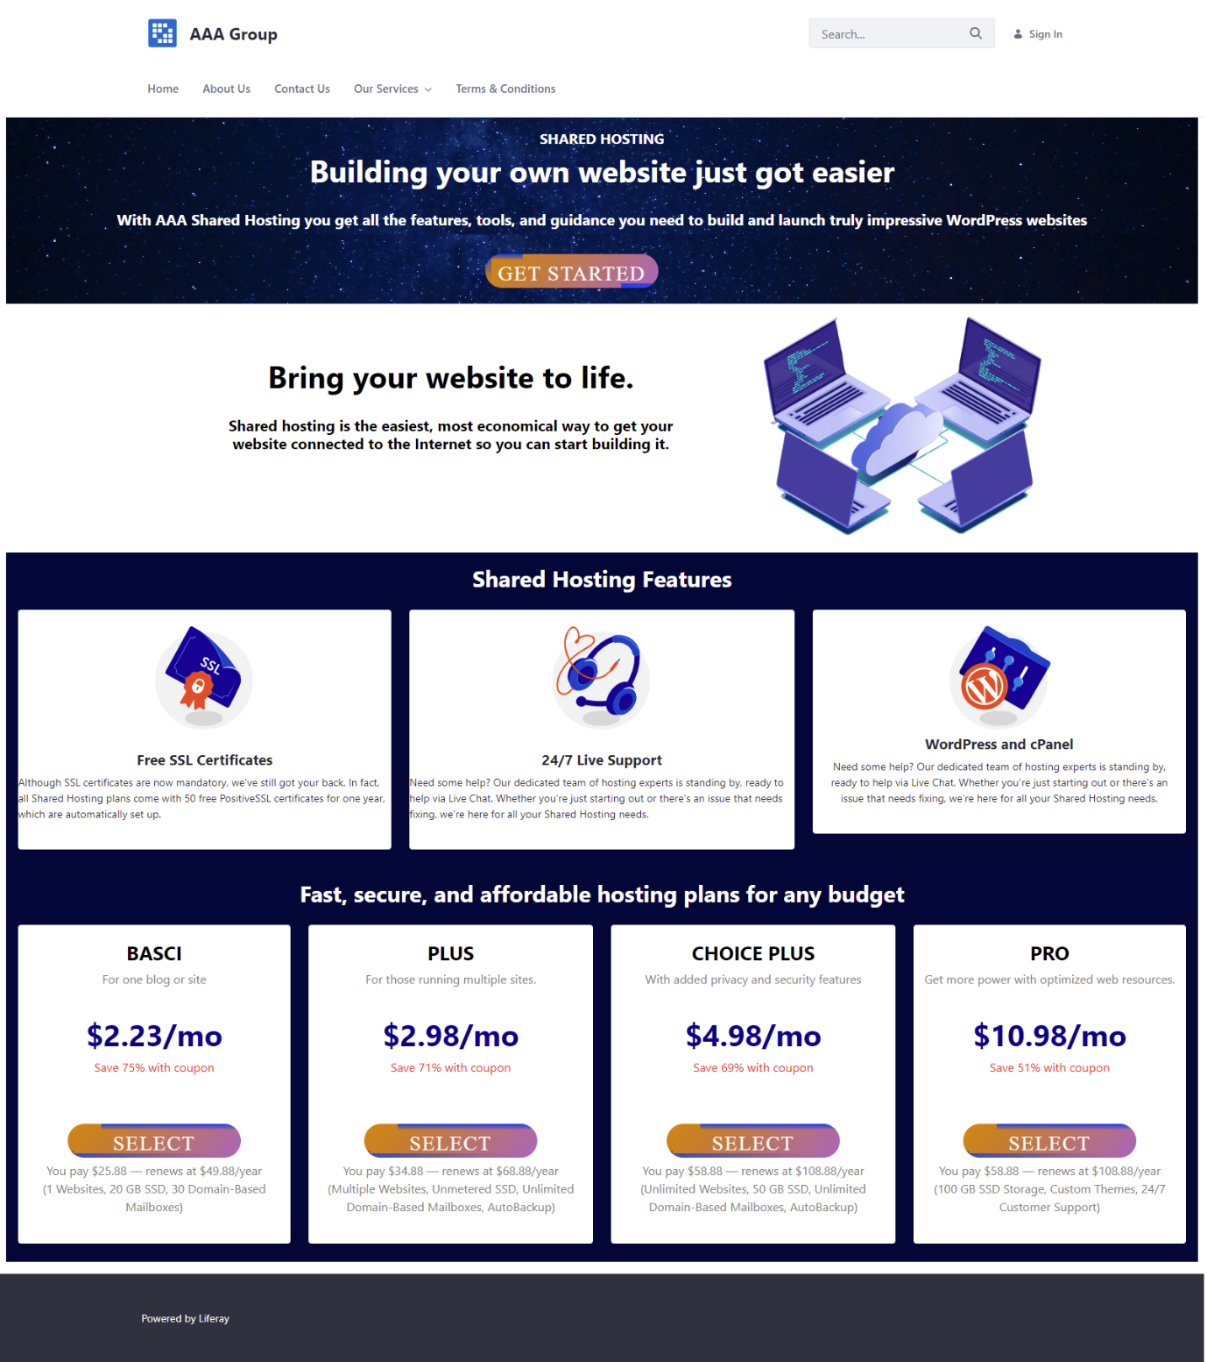
5. Developing Triple A portal
Shared Hosting

Slide 24
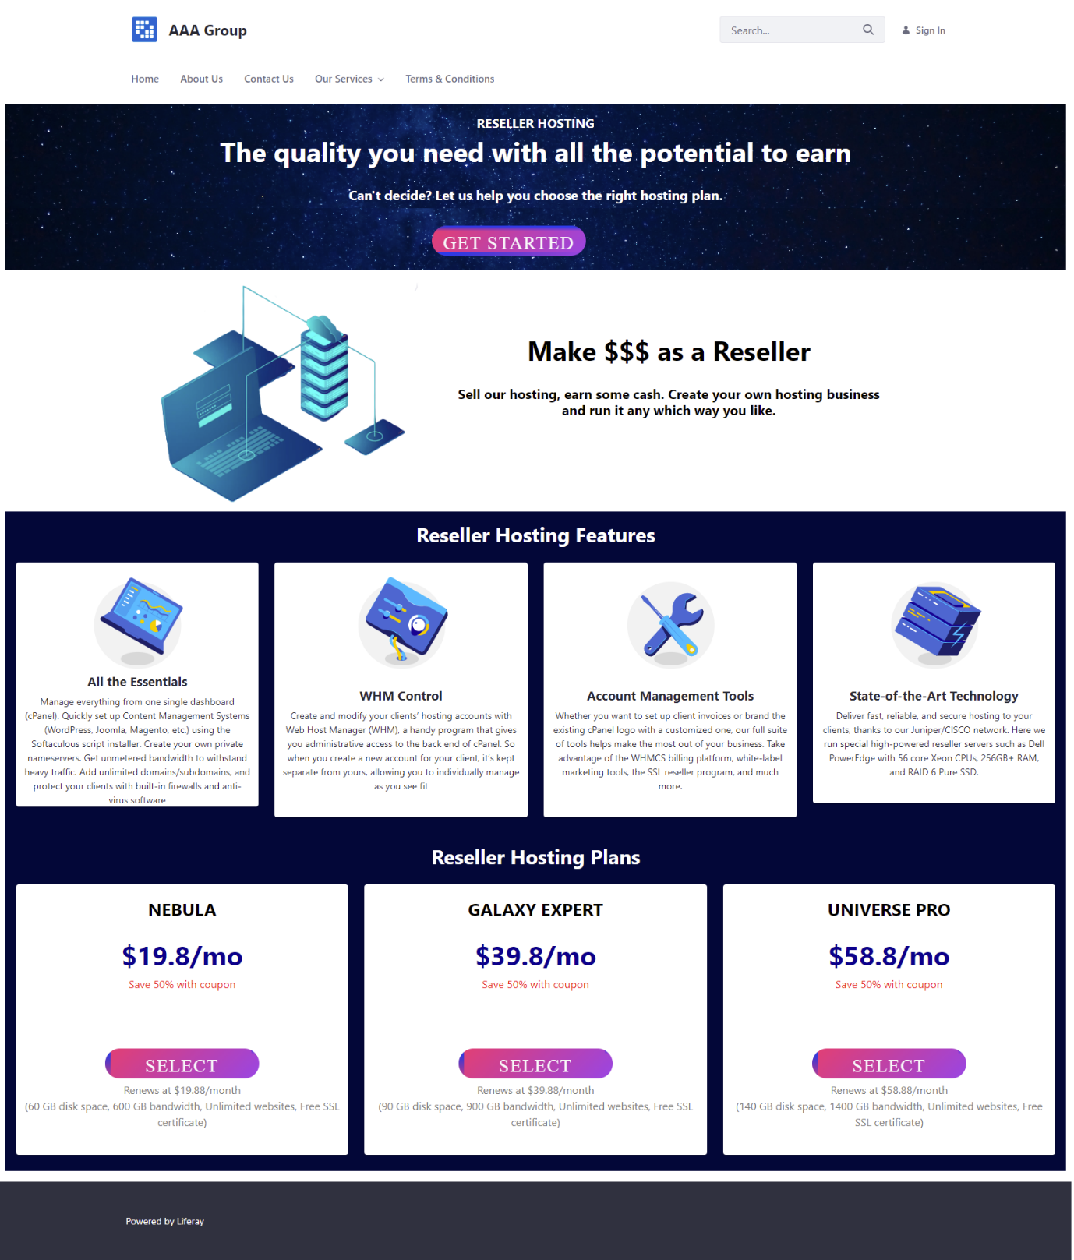
5. Developing Triple A portal
Reseller Hosting

Slide 25

5. Developing Triple A portal
Cloud Hosting

Slide 26

5. Developing Triple A portal
VPS Hosting

Slide 27

5. Developing Triple A portal
Dedicated Hosting

Slide 28
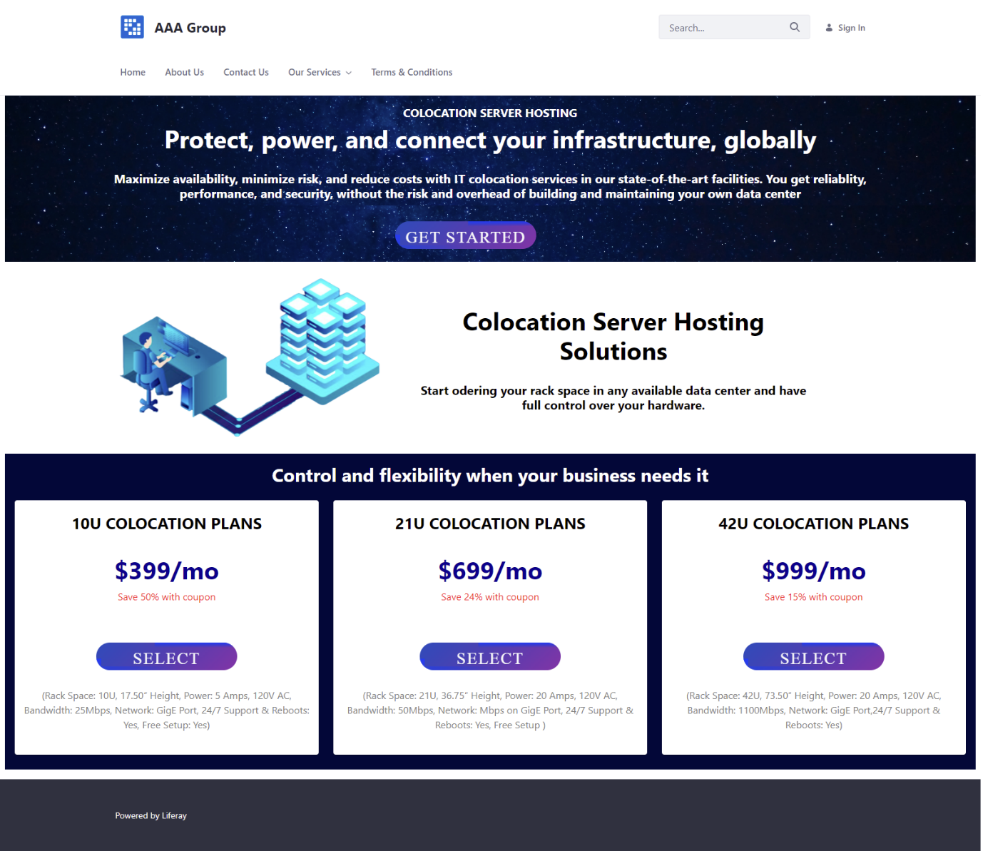
5. Developing Triple A portal
Colocation Server Hosting

Slide 29
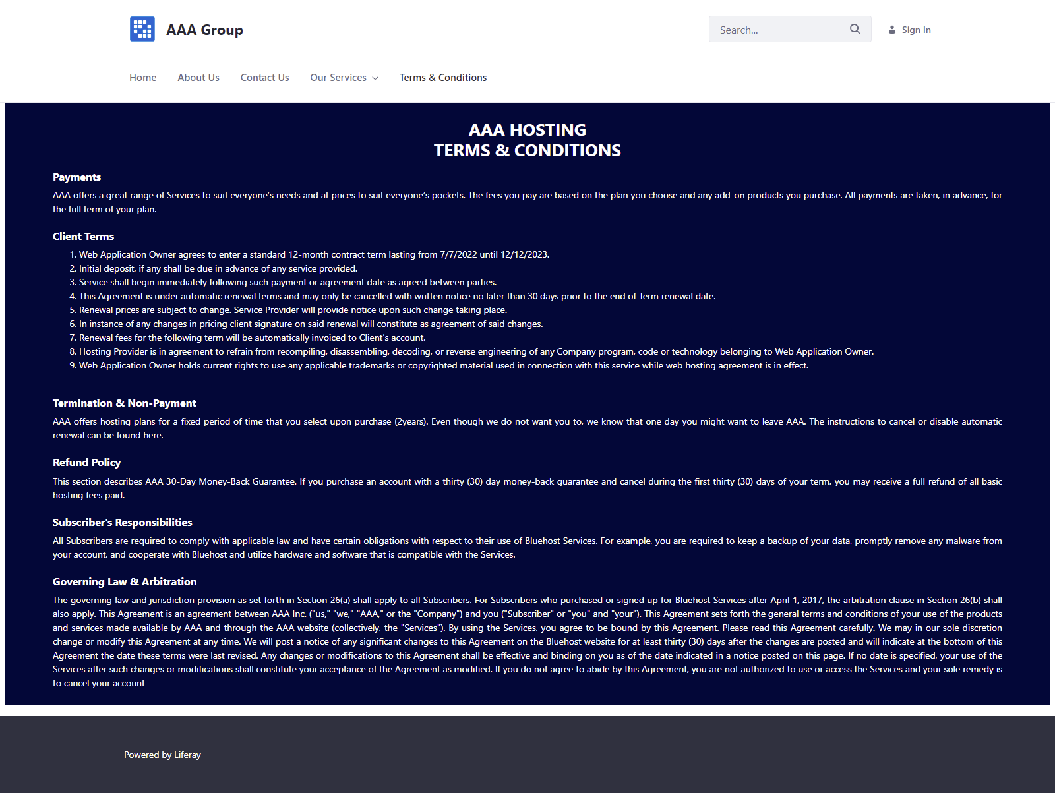
5. Developing Triple A portal
Terms & Conditions

Slide 30
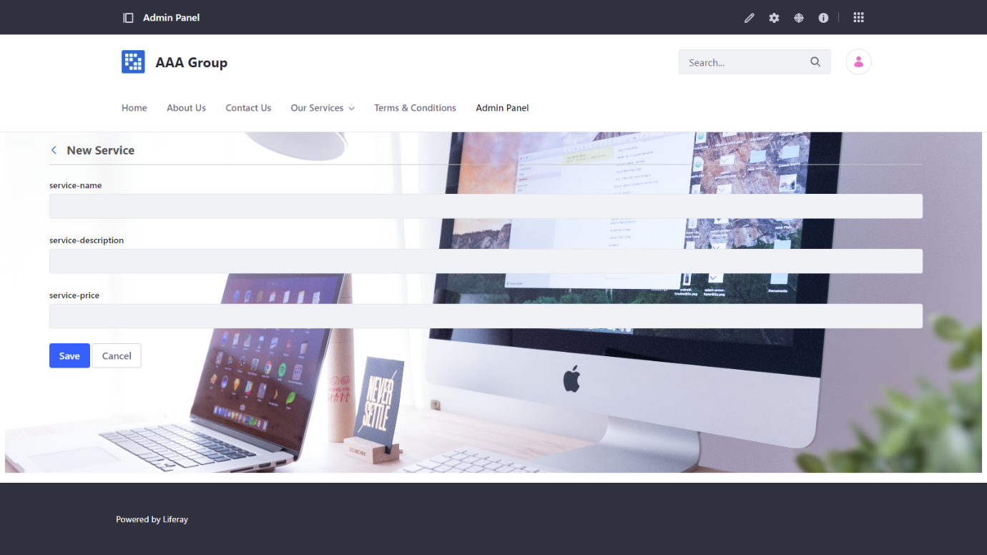
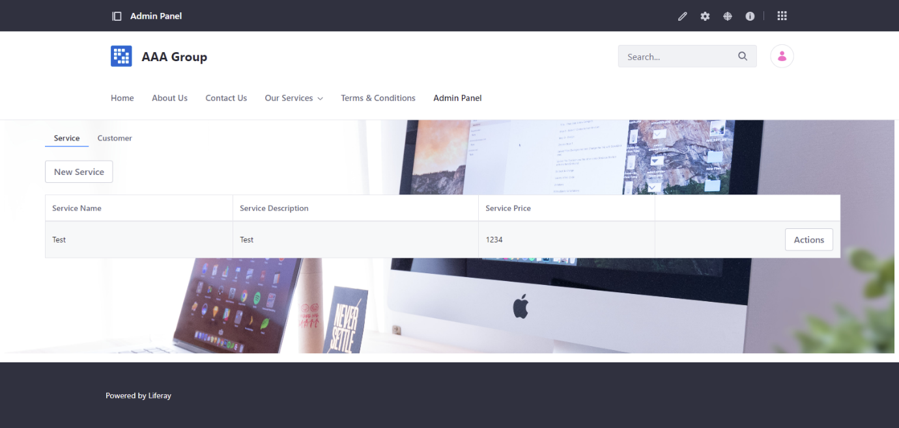
6. Customer Management Portlet
Manage Service & Customer (Service)

Slide 31
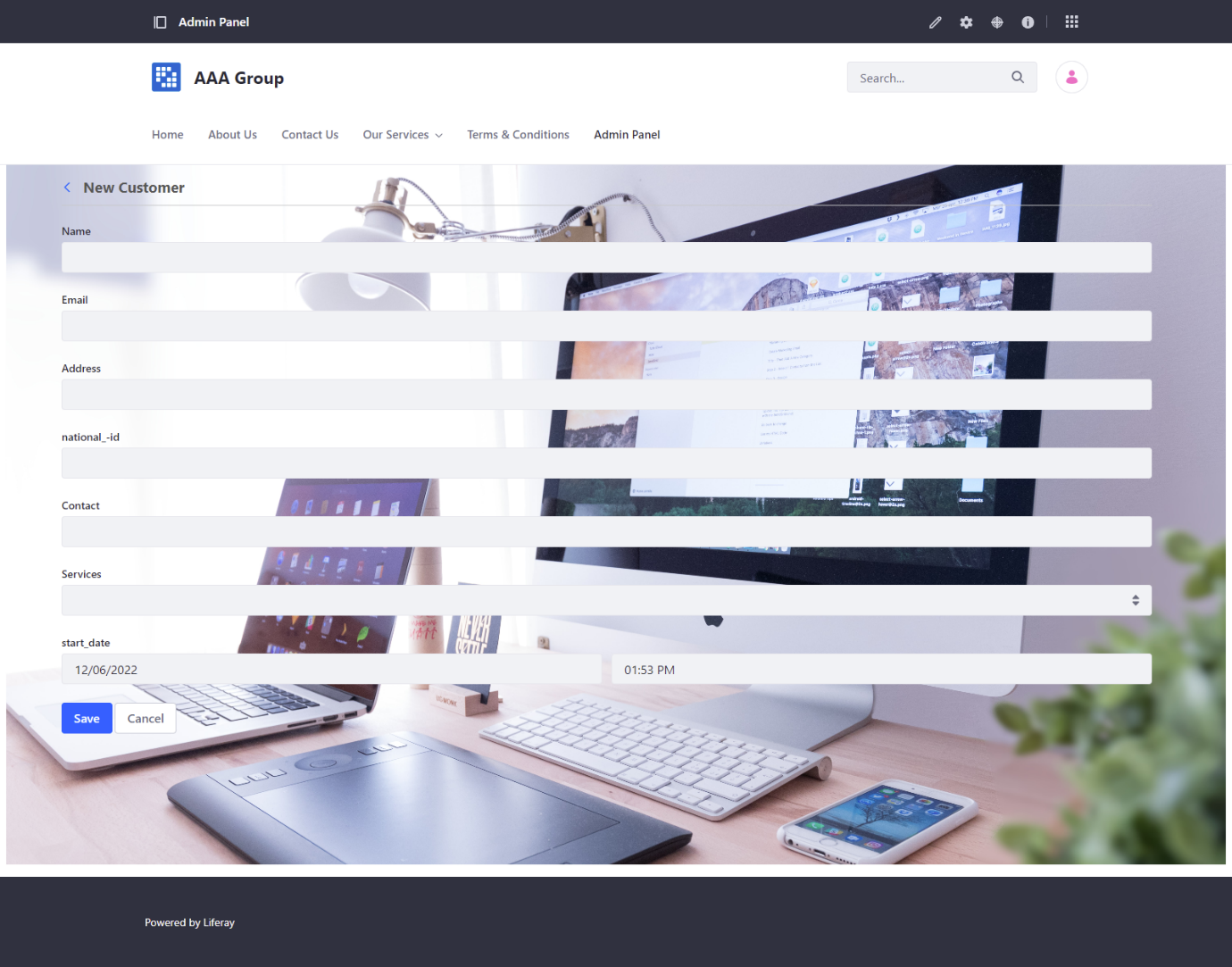
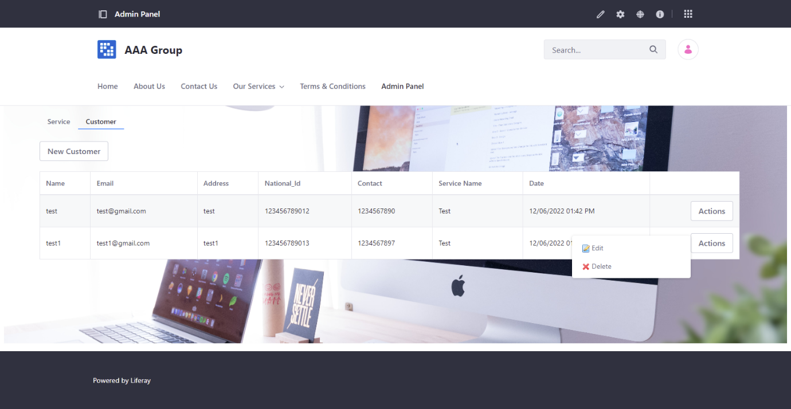
6. Customer Management Portlet
Manage Service & Customer (Customer)

Slide 32
7. Design Patterns
Usage of Design Pattern in Software Development
The usage of design patterns in the Triple A Portlet is critical for maintaining neat and smooth code. even though the portlet has many layers of services and classes, no longer each design pattern might be useful when utilized by the portlet. We have to use this information to determine the best and best design pattern for the portlet. due to the multiple layers of java classes, the portlet has already used the factory pattern. And, due to the fact we don't use any filtering functions in the portlet, the usage of the filter out sample is probably now not the best pattern to adapt into it. specifically given how the portlet implements the method and the fact that there are multiple layers of java classes.

Slide 33
8. Creational Design Patterns
In software engineering, creational design patterns are design patterns that cope with object introduction mechanisms, trying to create objects in a way suitable to the state of affairs. The basic form of item creation could result in design problems or in brought complexity to the design. Creational design patterns are concerned with the manner of making objects. So those design patterns are used while a decision ought to be made at the time of instantiation of a class
Factory Method Pattern | Define an interface or abstract class for developing an object however permit the subclasses to decide which class to instantiate
Abstract Factory Pattern | Define an interface or abstract class for creating families of related objects however without specifying their concrete sub-classes.
Singleton Pattern | Define a class that has the most effective example and presents a worldwide point of access to it
Prototype Pattern | Cloning of a current object as opposed to creating a new one can also be custom designed according to the requirement.
Builder Pattern | Construct a complex object from simple objects the usage of step-by means of-step approach

Slide 34
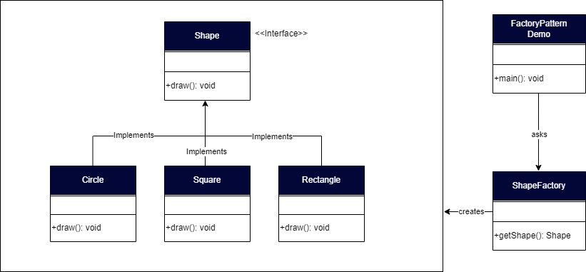
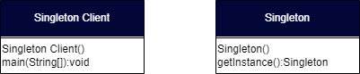
8. Creational Design Patterns
Façtory Pattern
Singleton

Slide 35
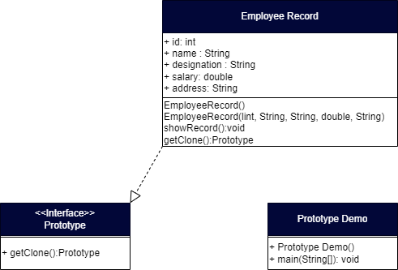
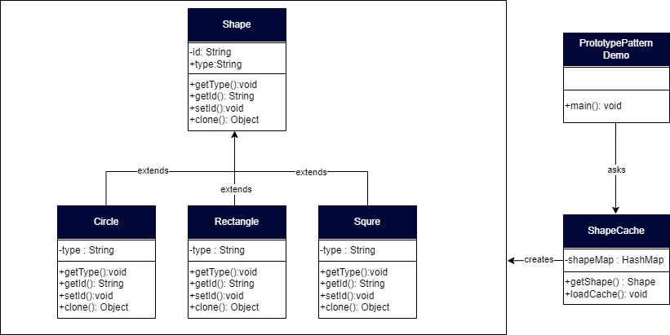
8. Creational Design Patterns
Prototype

Slide 36
9. Structural Design Patterns
Structural design pattern is a blueprint of the way one of a kind objects and classes are mixed collectively to form a bigger structure for reaching multiple goals altogether. The patterns in structural designs show how specific portions of a system can be combined collectively in an extensible and bendy way
Adapter Pattern | Allows in converting the interface of a class into any other interface depending at the consumer's requirements
Bridge Pattern | To split the implementation element from the abstraction component in order that the abstraction and implementation of a class can range independently
Composite Pattern | The client is able to perform objects which may additionally or won't represent its hierarchy
Decorator Pattern | Can add or remove object functionality without converting the function or external look of the object
Façade Pattern | Offer a simplified interface to a set of interfaces of a subsystem for hiding its complexity of subsystem from the customer
Flyweight Pattern | To reuse comparable forms of existing objects with the aid of storing and developing new objects while similar objects are not observed
Proxy Pattern | Provide a placeholder or a surrogate object to control access to the authentic object

Slide 37
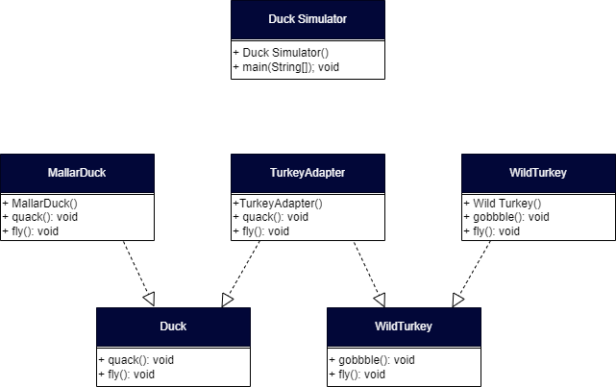
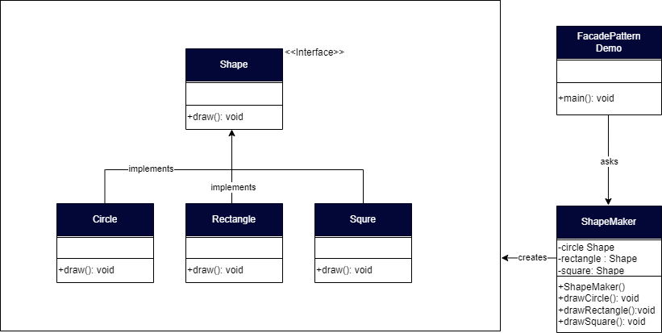
9. Structural Design Patterns
Adapter Pattern
Façade Pattern

Slide 38
10. Behavioral Design Patterns
Behavioral design patterns are involved with the interaction and duty of objects. In those design patterns, the interplay between the objects ought to be in this sort of manner that they are able to easily communicate to every different and still need to be loosely coupled. This means the implementation and the client ought to be loosely coupled so as to keep away from hard coding and dependencies.
There are 12 types of behavioral design patterns:
Chain of Responsibility Pattern
Command Pattern
Interpreter Pattern
Iterator Pattern
Mediator Pattern
Memento Pattern
Observer Pattern
State Pattern
Strategy Pattern
Template Pattern
Visitor Pattern
Null Object

Slide 39
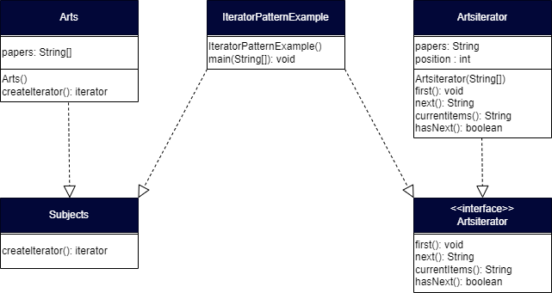
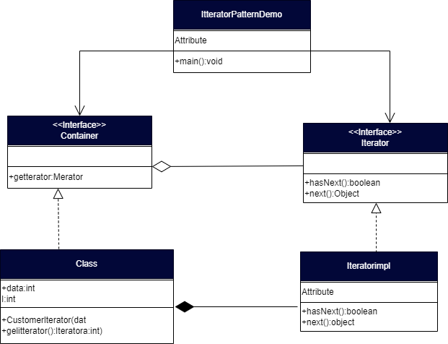
10. Behavioral Design Patterns
Iterator Pattern

Slide 40
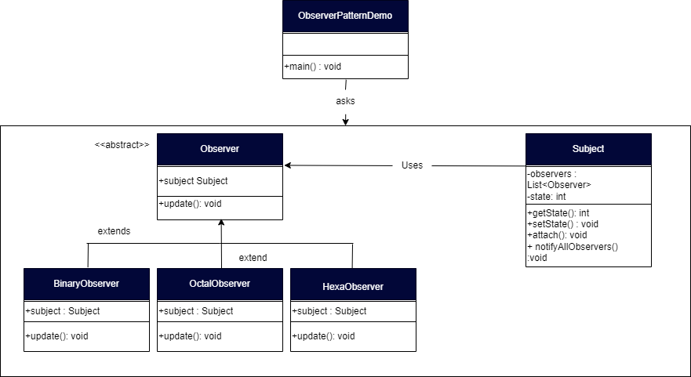
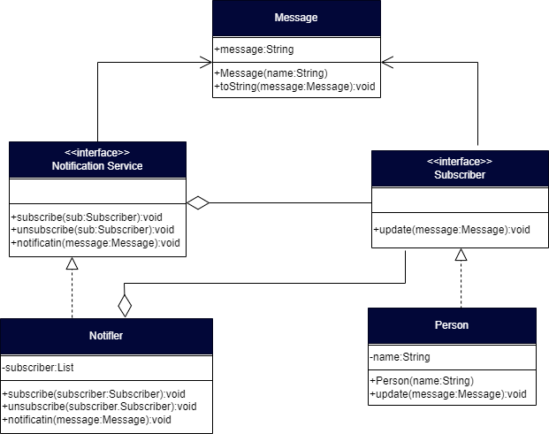
10. Behavioral Design Patterns
Observer Pattern

Slide 41
11. Milestone Feedback & Action taken
Project Milestone ID | Milestone Feedback received from Tutor / Learning Facilitator | Action Taken (Yes / No)
1 | Change Tomcat Bundle Version | Yes
 | Add more details for home Page | Yes
2 | Connect Database | Yes
 |  | Yes
3

